Slide 1
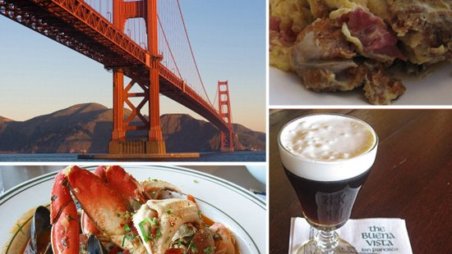

San Francisco Health Department inspection reports and scoring for restaurants
By Melissa Fallon

Slide 2
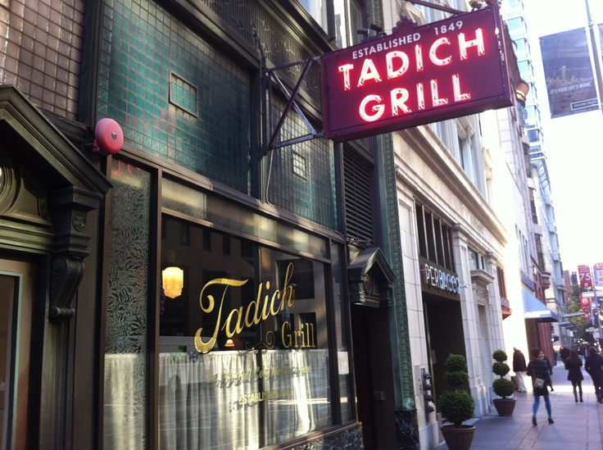
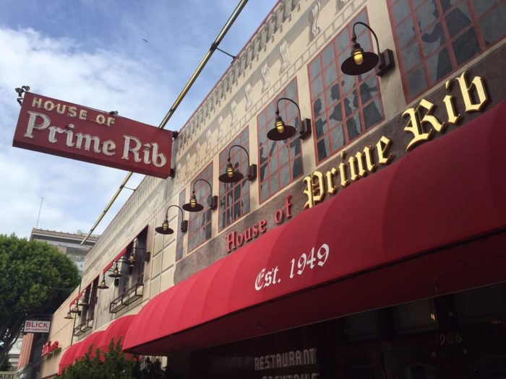
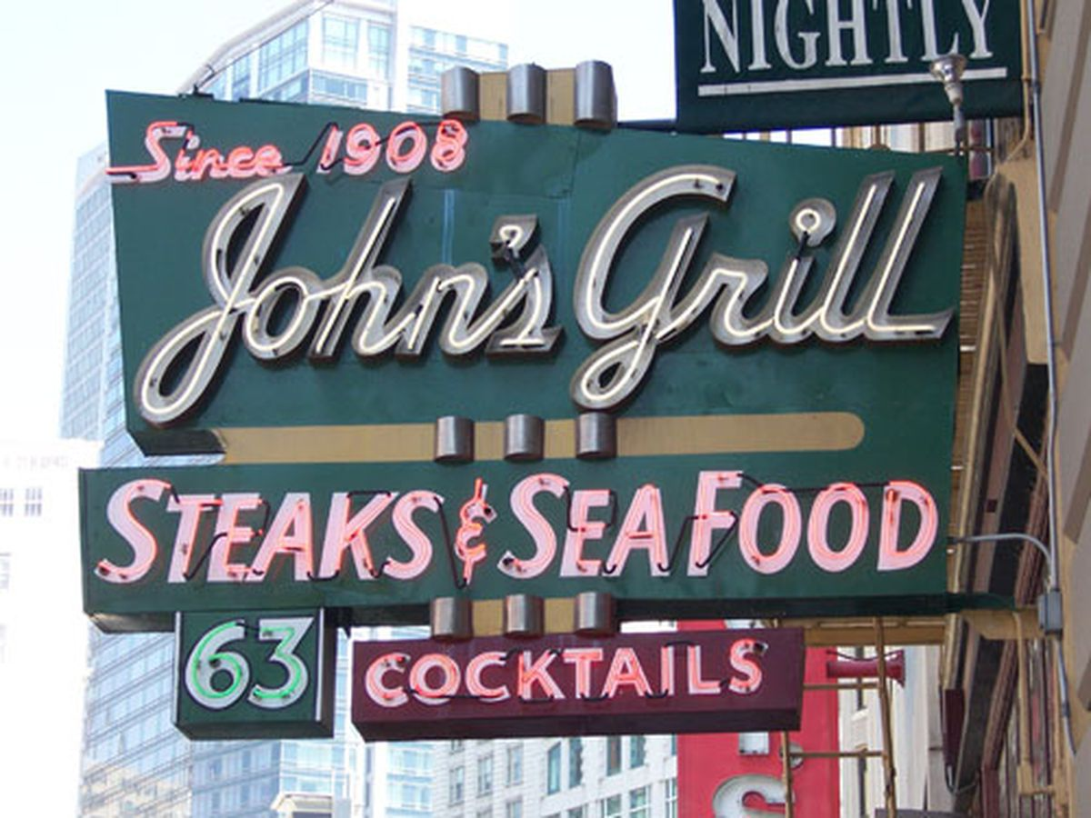
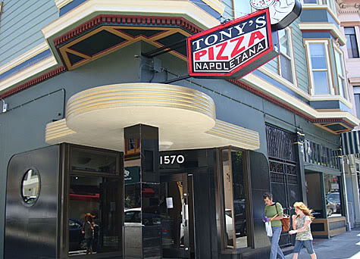
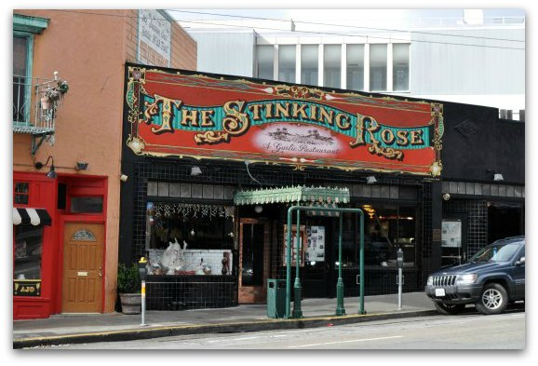
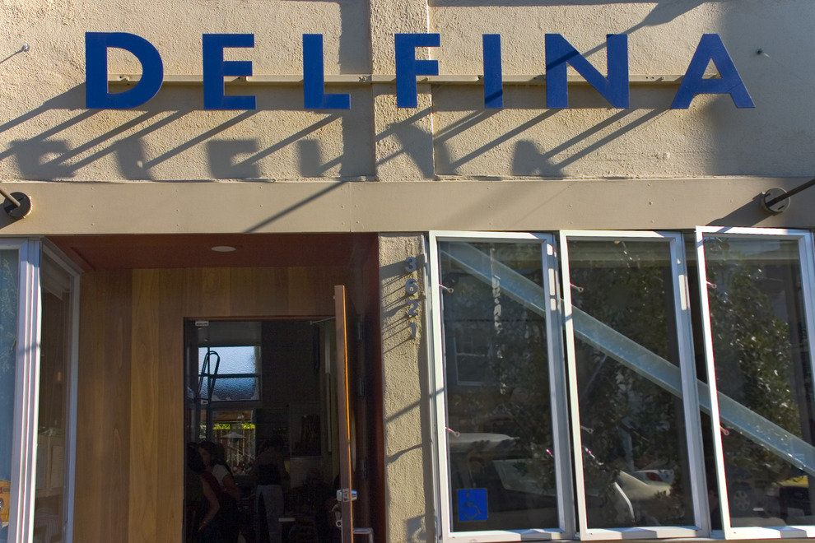
There are more than 8,000 restaurants and 700 bars within 15 miles of Downtown San Francisco, making the city one of the top culinary destinations in the country.
Notes:
https://www.thrillist.com/entertainment/san-francisco/wtf-san-francisco-statistics

Slide 3






Score: 96
Score: 96
Score: 87
Score: 86
Score: 92
Some of the most famous of these restaurants have high health scores along with high customer ratings. However…
Score: 94
Notes:
https://www.thrillist.com/entertainment/san-francisco/wtf-san-francisco-statistics

Slide 4
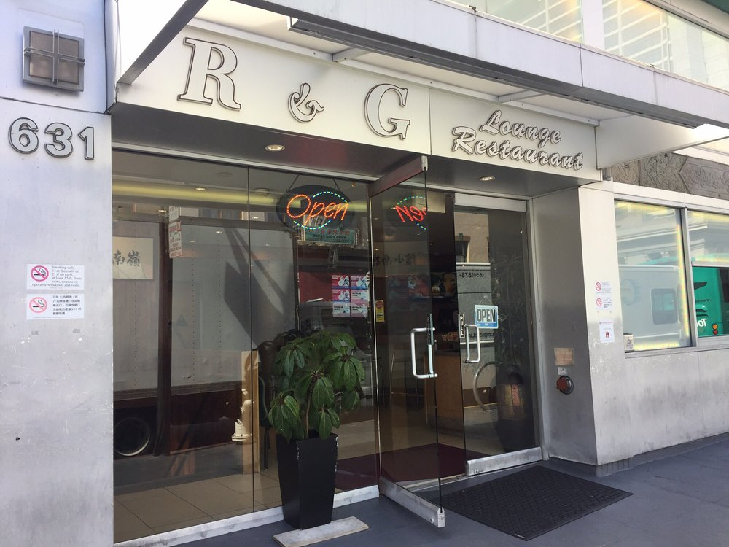
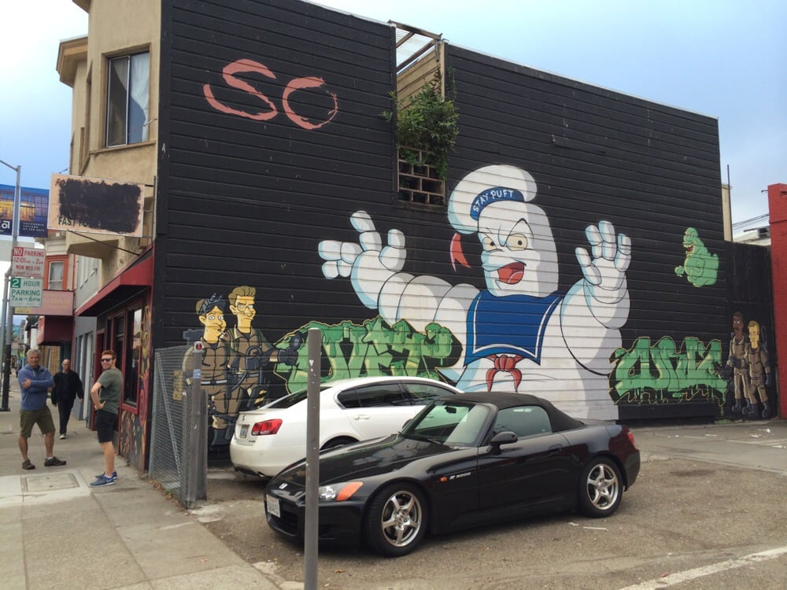




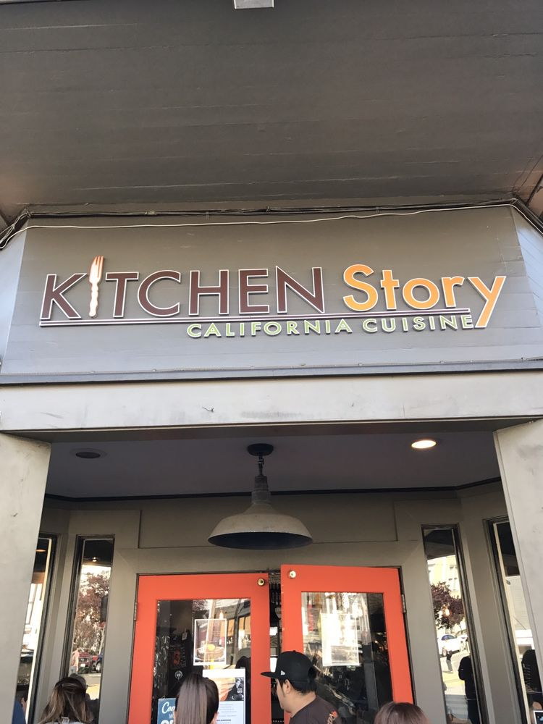
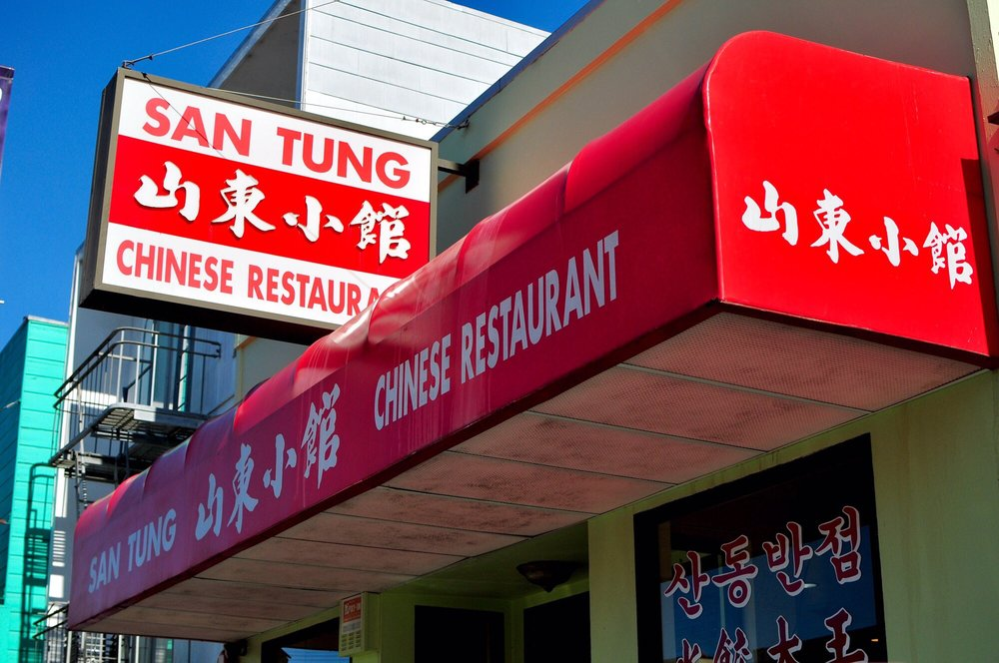




High ratings and reputation do not always equal a good health score!
.

Slide 5

Data Set
From the San Francisco Department of Heath Food Safety (data.world)
Records are from a three year period (July 19, 2013-July 19, 2016)
Data sets include data on businesses, inspections, and violations
Total Number of Records: 40, 671
Total Number of Restaurants Inspected: 7557, with 27,450 total inspections.
Restaurants scoring based on High, Moderate, and Low Risk.
These risks include: Inadequate and inaccessible handwashing facilities, improper food storage, high risk food holding temperature, and scary of all, high risk vermin infestation.
Notes:
MasterData Replaced 'S.F.' and 'SF' city values with 'San Francisco' Checked for missing and Null values Replaced and combined identical values in owner city

Slide 6
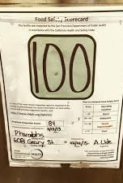
Overview
When it comes to areas of the city, which neighborhoods have the best and worst health scores?
HOW CAN THESE HEATH FOOD SCORES INPACT TOURISM?
What Are the Trends we see?

Slide 7
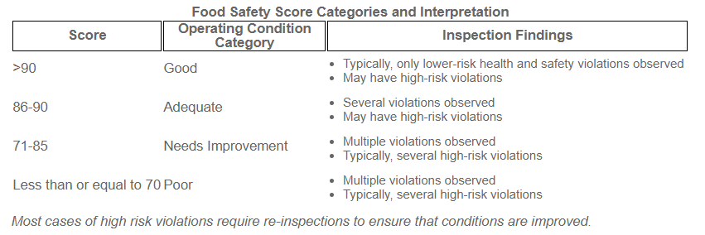

Slide 8
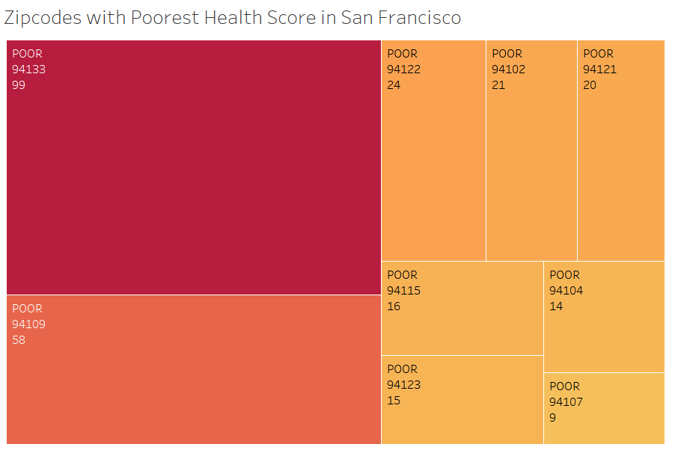

Slide 9
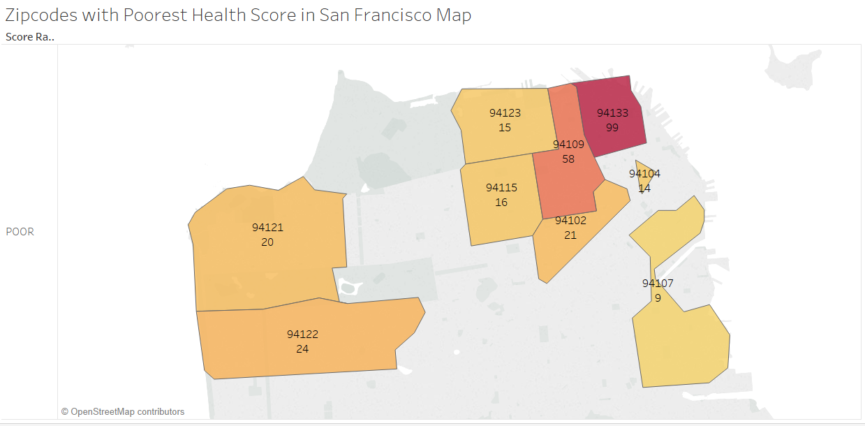
#1 94133-NorthbeaCh/ China town
#2 94109- Russian hill/ nob hill

Slide 10
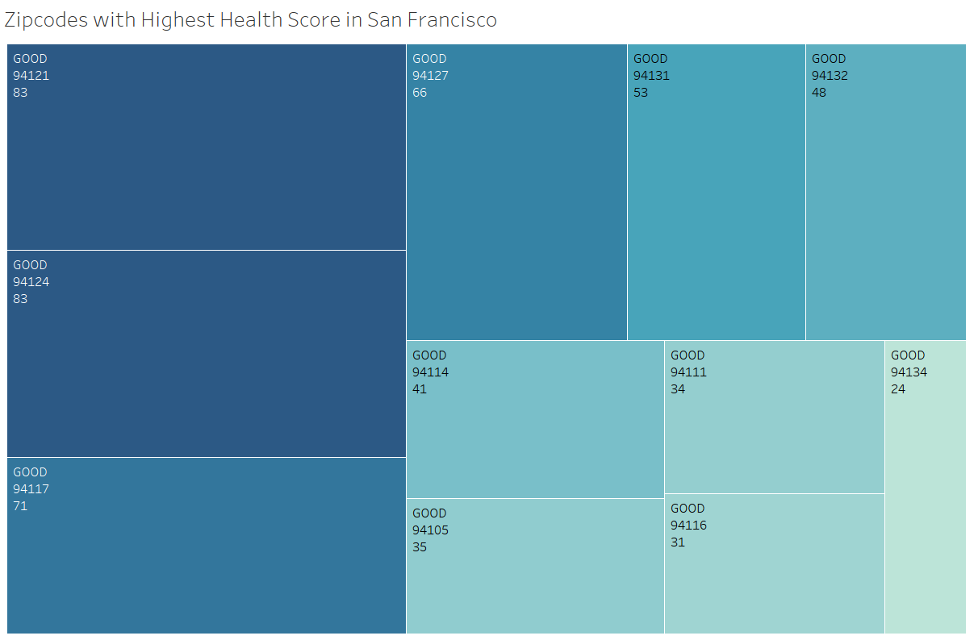

Slide 11
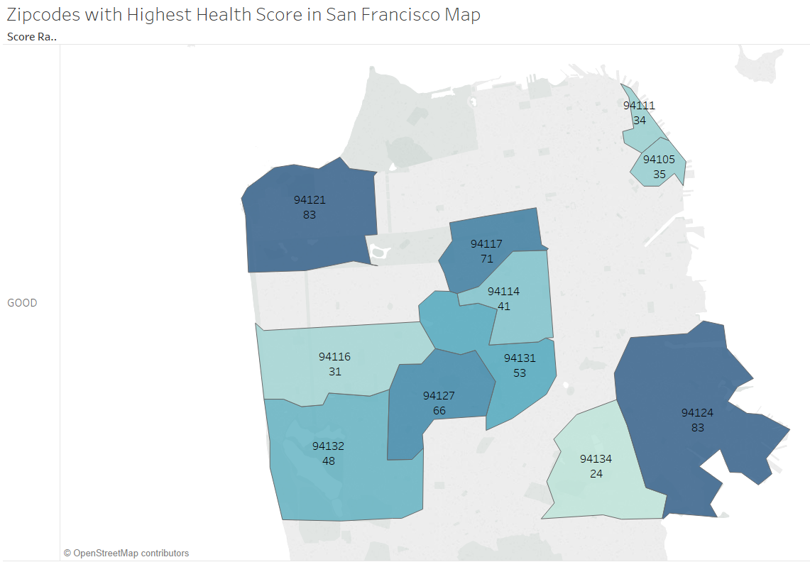
#1 94121: Outer Richmond
#3 94117: Haight-Ashbury
#5 94131: Twin Peaks-Glen Park/Noe Valley
#2 94124: Bayview-Hunters Point
#4 94127: St. Francis Wood/Miraloma/West Portal

Slide 12
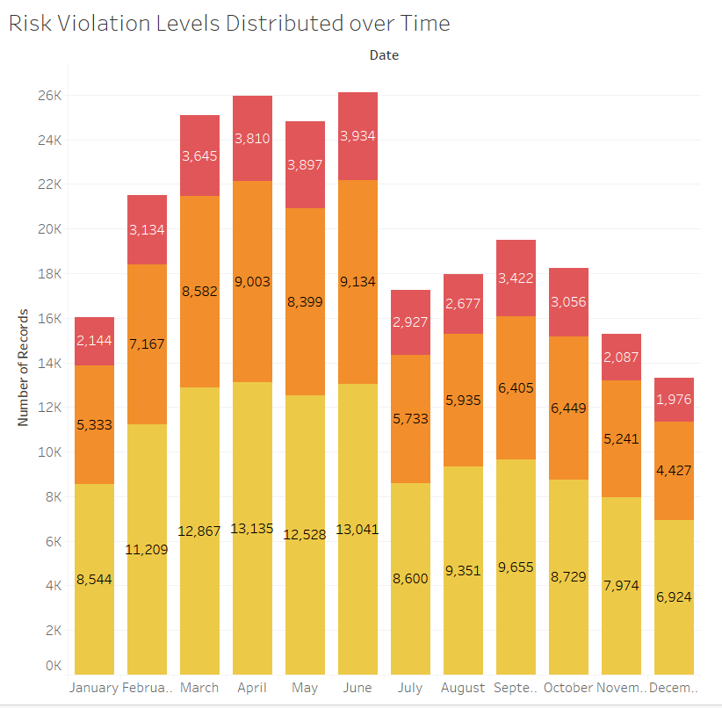

Highest times of the year restaurants
receive heath violations
is March through June. Which happen to be
peak times of San Francisco tourism season.

Slide 13
Conclusions
Environment and location makes a lot of difference in whether or not a restaurant will receive a poor health food score.
High Tourism seasons (Spring and Summer) show an increase in poor health rating.

Slide 14
Recommendations
Along with customer satisfaction, have final recommendations have some basis on health food score.
Provide recommendations of restaurants in neighborhoods not as well known by tourists (aka. Hunter’s Point/ Bayview) for dinning options.

Slide 15
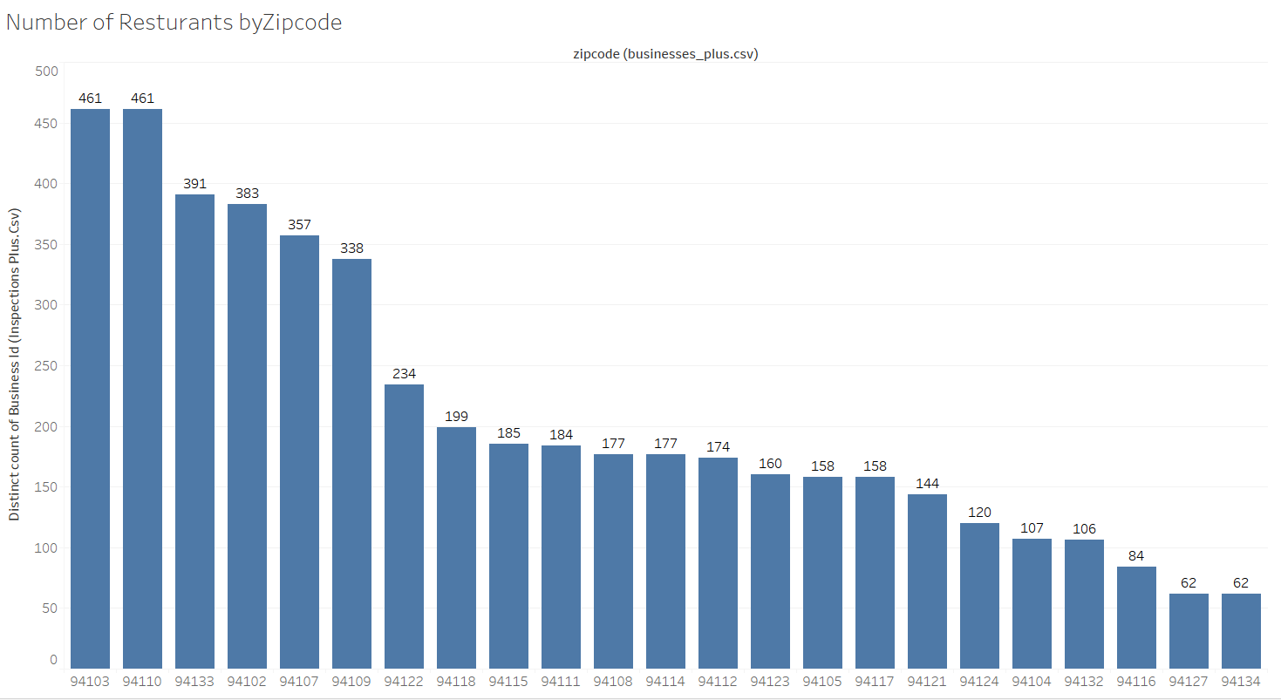
Next Steps/Limitations
Exploring how scores are reflected by cuisine type.
For restaurants with high health food scores in zip code with the poorest health food scores, what simplistic strategies are being utilized to keep scores high to pass onto other under preforming restaurants in the area.
Looking more in-depth into the ratio of number of restaurants in each zip code compared to health rating.
Pulling from other data sources and more recent health food scores to show improvements . Many restaurants from list may have shut down.

